Slide 1
Best Practices for Data Warehousing with Amazon Redshift

Slide 2
Amazon Redshift Overview

Slide 3
What is Redshift
Database designed for analytical processing (OLAP)
NOT designed for online transaction processing (OLTP)
NOT ideal for datasets < 100GB
NOT designed for BLOB data
OLAP | OLTP
Batched write operations | Continuous write operations
Read high volumes of data | High volumes of small read operations

Slide 4
Amazon Redshift 10x faster at 1/10th the cost
Fast
Simple
Cost-effective
Delivers fast results for all types of workloads
Create and start using a data warehouse in minutes
No upfront costs, start small, and pay as you go
Scalable
Integrated
Secure
Gigabytes to petabytes
to exabytes
Integrated with S3 data lakes,
AWS services and third-party tools
Audit everything; encrypt data end-to-end; extensive certification and compliance

Slide 5
Amazon Redshift Architecture

Slide 6
Amazon Redshift Cluster Architecture
Massively parallel, shared nothing
Leader node
SQL endpoint
Stores metadata
Coordinates parallel SQL processing
Compute nodes
Local, columnar storage
Executes queries in parallel
Load, backup, restore
SQL Clients/BI Tools
JDBC/ODBC
Leader Node
128GB RAM
16 cores
16TB disk
10 GigE
(HPC)
Compute Node
Compute Node
Compute Node
128GB RAM
128GB RAM
128GB RAM
16 cores
16 cores
16 cores
16TB disk
16TB disk
16TB disk
Ingestion
Backup
Restore
S3 / EMR / DynamoDB / SSH

Slide 7
Leader Node
128GB RAM
16 cores
16TB disk
Compute Node
Compute Node
Compute Node
128GB RAM
128GB RAM
128GB RAM
16 cores
16 cores
16 cores
16TB disk
16TB disk
16TB disk

Slide 8
Parser & rewriter
Planner & optimizer
Code generator
Input: optimized plan
Output: >=1 C++ functions
Compiler
Task scheduler
WLM
Admission
Scheduling
PostgreSQL catalog tables
Leader Node
128GB RAM
16 cores
16TB disk
Compute Node
Compute Node
Compute Node
128GB RAM
128GB RAM
128GB RAM
16 cores
16 cores
16 cores
16TB disk
16TB disk
16TB disk

Slide 9
Query execution processes
Backup & restore processes
Replication processes
Local Storage
Disks
Slices
Tables
Columns
Blocks
Leader Node
128GB RAM
16 cores
16TB disk
Compute Node
Compute Node
Compute Node
128GB RAM
128GB RAM
128GB RAM
16 cores
16 cores
16 cores
16TB disk
16TB disk
16TB disk

Slide 10
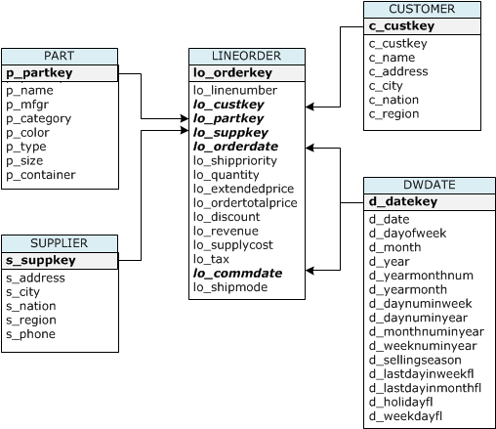
Demo – Cluster Creation & Load Data - Star Schema Benchmark (SSB)

Slide 11
Designed for I/O Reduction
CREATE TABLE deep_dive (
aid INT --audience_id
,loc CHAR(3) --location
,dt DATE --date
);
Columnar storage
Data compression
Zone maps
aid | loc | dt
1 | SFO | 2016-09-01
2 | JFK | 2016-09-14
3 | SFO | 2017-04-01
4 | JFK | 2017-05-14
aid
loc
dt
Accessing dt with row storage:
Need to read everything
Unnecessary I/O

Slide 12
Designed for I/O Reduction
Designed for I/O Reduction
CREATE TABLE deep_dive (
aid INT --audience_id
,loc CHAR(3) --location
,dt DATE --date
);
Columnar storage
Data compression
Zone maps
aid | loc | dt
1 | SFO | 2016-09-01
2 | JFK | 2016-09-14
3 | SFO | 2017-04-01
4 | JFK | 2017-05-14
aid
loc
dt
Accessing dt with columnar storage
Only scan blocks for relevant column

Slide 13
Designed for I/O Reduction
CREATE TABLE deep_dive (
aid INT ENCODE LZO
,loc CHAR(3) ENCODE BYTEDICT
,dt DATE ENCODE RUNLENGTH
);
Columnar storage
Data compression
Zone maps
aid | loc | dt
1 | SFO | 2016-09-01
2 | JFK | 2016-09-14
3 | SFO | 2017-04-01
4 | JFK | 2017-05-14
aid
loc
dt
Columns grow and shrink independently
Reduces storage requirements
Reduces I/O

Slide 14
Designed for I/O Reduction
CREATE TABLE deep_dive (
aid INT --audience_id
,loc CHAR(3) --location
,dt DATE --date
);
Columnar storage
Data compression
Zone maps
aid | loc | dt
1 | SFO | 2016-09-01
2 | JFK | 2016-09-14
3 | SFO | 2017-04-01
4 | JFK | 2017-05-14
aid
loc
dt
In-memory block metadata
Contains per-block MIN and MAX value
Effectively prunes blocks which cannot contain data for a given query
Eliminates unnecessary I/O

Slide 15
Slices
Compute Node
Slices
Disks
Columns
Blocks
A slice can be thought of like a “virtual compute node”
Unit of data partitioning
Parallel query processing
Facts about slices:
Each compute node has either 2, 16, or 32 slices
Table rows are distributed to slices
A slice processes only its own data

Slide 16
Disks
Compute Node
Slices
Disks
Columns
Blocks
Amazon Redshift uses locally attached storage devices
Compute nodes have 2.5-3x the advertised storage capacity
1, 3, 8, or 24 disks depending on node type
Each disk is split into two partitions
Local data storage, accessed by local CN
Mirrored data, accessed by remote CN
Partitions are raw devices
Local storage devices are ephemeral in nature
Tolerant to multiple disk failures on a single node

Slide 17
Columns
Compute Node
Slices
Disks
Columns
Blocks
Column: Logical structure accessible via SQL
Physical structure is a doubly linked list of blocks
These blockchains exist on each slice for each column
All sorted & unsorted blockchains compose a column
Column properties include:
Distribution Key
Sort Key
Compression Encoding
Columns shrink and grow independently, 1 block at a time
Three system columns per table-per slice for MVCC

Slide 18
Blocks
Compute Node
Slices
Disks
Columns
Blocks
Column data is persisted to 1 MB immutable blocks
Each block contains in-memory metadata:
Zone Maps (MIN/MAX value)
Location of previous/next block
Blocks are individually compressed with 1 of 11 encodings
A full block contains between 16 and 8.4 million values

Slide 19
Table Design

Slide 20
Data Distribution Style
Distribution style is a table property which dictates how that table’s data is distributed throughout the cluster:
ALL: Full table data goes to first slice of every node
EVEN: Round robin
KEY: Value is hashed, same value goes to same location (slice)
Goals:
Distribute data evenly for parallel processing
Minimize data movement during query processing
ALL
KEY
EVEN
keyD
keyA
keyB
keyC
Node 1
Node 2
Node 1
Node 2
Node 1
Node 2
Slice 1
Slice 2
Slice 3
Slice 4
Slice 1
Slice 2
Slice 3
Slice 4
Slice 1
Slice 2
Slice 3
Slice 4

Slide 21
Data Distribution Style
Automatic distribution
If you don't specify a distribution style with the CREATE TABLE statement, Amazon Redshift applies automatic distribution. With automatic distribution, Amazon Redshift assigns an optimal distribution style based on the size of the table data. For example, Amazon Redshift initially assigns ALL distribution to a small table, then changes to EVEN distribution when the table grows larger. When a table is changed from ALL to EVEN distribution, storage utilization might change slightly. The change in distribution occurs in the background, in a few seconds.
You can't change the distribution style of a table after it's created. To use a different distribution style, you can recreate the table and populate the new table with a deep copy.

Slide 22
Data Distribution: Example
Table: deep_dive
User Columns |  |  | System Columns
aid | loc | dt | ins | del | row
CREATE TABLE deep_dive (
aid INT --audience_id
,loc CHAR(3) --location
,dt DATE --date
) DISTSTYLE (EVEN|KEY|ALL);
CN1
CN2
Slice 0
Slice 1
Slice 2
Slice 3

Slide 23
Data Distribution: EVEN Example
CREATE TABLE deep_dive (
aid INT --audience_id
,loc CHAR(3) --location
,dt DATE --date
) DISTSTYLE EVEN;
INSERT INTO deep_dive VALUES
(1, 'SFO', '2016-09-01'),
(2, 'JFK', '2016-09-14'),
(3, 'SFO', '2017-04-01'),
(4, 'JFK', '2017-05-14');
CN1
CN2
Slice 0
Slice 1
Slice 2
Slice 3
Table: loft_deep_dive
User Columns |  |  | System Columns
aid | loc | dt | ins | del | row
Table: loft_deep_dive
User Columns |  |  | System Columns
aid | loc | dt | ins | del | row
Table: loft_deep_dive
User Columns |  |  | System Columns
aid | loc | dt | ins | del | row
Table: loft_deep_dive
User Columns |  |  | System Columns
aid | loc | dt | ins | del | row
Rows: 1
Rows: 1
Rows: 0
Rows: 1
Rows: 0
Rows: 0
Rows: 0
Rows: 1
(3 User Columns + 3 System Columns) x (4 slices) = 24 Blocks (24 MB)

Slide 24
Data Distribution: KEY Example #1
CREATE TABLE deep_dive (
aid INT --audience_id
,loc CHAR(3) --location
,dt DATE --date
) DISTSTYLE KEY DISTKEY (loc);
INSERT INTO deep_dive VALUES
(1, 'SFO', '2016-09-01'),
(2, 'JFK', '2016-09-14'),
(3, 'SFO', '2017-04-01'),
(4, 'JFK', '2017-05-14');
CN1
CN2
Slice 0
Slice 1
Slice 2
Slice 3
Table: loft_deep_dive
User Columns |  |  | System Columns
aid | loc | dt | ins | del | row
Table: loft_deep_dive
User Columns |  |  | System Columns
aid | loc | dt | ins | del | row
Rows: 2
Rows: 0
Rows: 1
Rows: 0
Rows: 1
Rows: 0
Rows: 2
Rows: 0
(3 User Columns + 3 System Columns) x (2 slices) = 12 Blocks (12 MB)

Slide 25
Data Distribution: KEY Example #2
CREATE TABLE deep_dive (
aid INT --audience_id
,loc CHAR(3) --location
,dt DATE --date
) DISTSTYLE KEY DISTKEY (aid);
INSERT INTO deep_dive VALUES
(1, 'SFO', '2016-09-01'),
(2, 'JFK', '2016-09-14'),
(3, 'SFO', '2017-04-01'),
(4, 'JFK', '2017-05-14');
CN1
CN2
Slice 0
Slice 1
Slice 2
Slice 3
Table: loft_deep_dive
User Columns |  |  | System Columns
aid | loc | dt | ins | del | row
Table: loft_deep_dive
User Columns |  |  | System Columns
aid | loc | dt | ins | del | row
Table: loft_deep_dive
User Columns |  |  | System Columns
aid | loc | dt | ins | del | row
Table: loft_deep_dive
User Columns |  |  | System Columns
aid | loc | dt | ins | del | row
Rows: 1
Rows: 1
Rows: 0
Rows: 1
Rows: 0
Rows: 0
Rows: 0
Rows: 1
(3 User Columns + 3 System Columns) x (4 slices) = 24 Blocks (24 MB)

Slide 26
Data Distribution: ALL Example
CREATE TABLE loft_deep_dive (
aid INT --audience_id
,loc CHAR(3) --location
,dt DATE --date
) DISTSTYLE ALL;
INSERT INTO deep_dive VALUES
(1, 'SFO', '2016-09-01'),
(2, 'JFK', '2016-09-14'),
(3, 'SFO', '2017-04-01'),
(4, 'JFK', '2017-05-14');
CN1
CN2
Slice 0
Slice 1
Slice 2
Slice 3
Table: loft_deep_dive
User Columns |  |  | System Columns
aid | loc | dt | ins | del | row
Table: loft_deep_dive
User Columns |  |  | System Columns
aid | loc | dt | ins | del | row
Rows: 4
Rows: 4
Rows: 0
Rows: 3
Rows: 1
Rows: 0
Rows: 2
Rows: 3
Rows: 1
Rows: 0
Rows: 0
Rows: 2
(3 User Columns + 3 System Columns) x (2 slice) = 12 Blocks (12 MB)

Slide 27
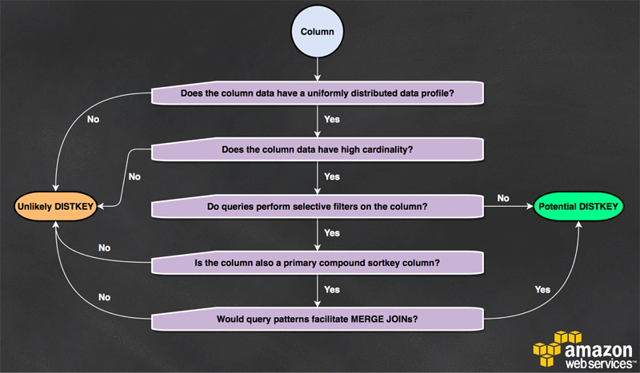
1) Deciding Distribution Key

Slide 28
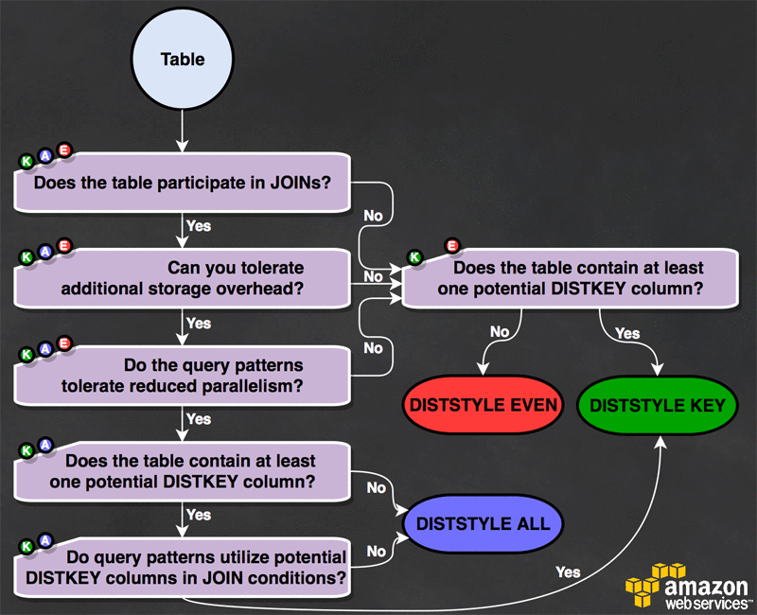
2) Deciding Distribution Style

Slide 29
Sort Keys
Goals:
Physically order rows of table data based on certain column(s)
Optimize effectiveness of zone maps
Enable MERGE JOIN operations
When you create a table, you can define one or more of its columns as sort keys.
Amazon Redshift allows for a table to be defined with
compound sort keys
interleaved sort keys
no sort keys
In practice, a compound sort key is most appropriate for the vast majority of workloads.
To understand the impact of the chosen sort key on query performance, use the EXPLAIN command.

Slide 30
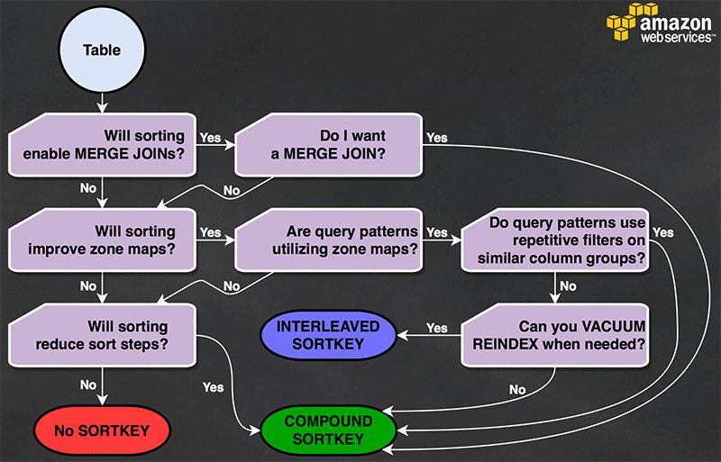
Deciding Sort Keys

Slide 31
Column’s Compression Type
You can apply a compression type, or encoding, to the columns in a table
manually when you create the table, or
you can use the COPY command to analyze and apply compression automatically <= strongly recommended
Encoding types
Raw Encoding
Byte-Dictionary Encoding
Delta Encoding
LZO Encoding
Mostly Encoding
Runlength Encoding
Text255 and Text32k Encodings
Zstandard Encoding

Slide 32
Constraints Definition
Uniqueness, primary key, and foreign key constraints are informational only, not enforced by Amazon Redshift.
Nonetheless
primary keys and foreign keys are used as planning hints
they should be declared if your ETL process or some other process in your application enforces their integrity.

Slide 33
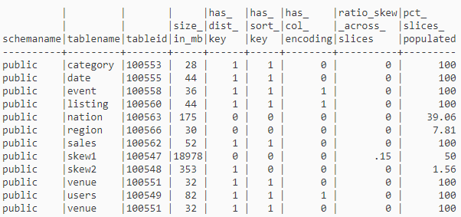
Design Analysis
https://docs.aws.amazon.com/redshift/latest/dg/c_analyzing-table-design.html
ratio_skew_across_slices
=> small is good
pct_slices_populated
=> large is good

Slide 34
Demo – Tuning Baseline

Slide 35
Redshift Spectrum

Slide 36






Amazon Redshift Spectrum Run SQL queries directly against data in S3 using thousands of nodes
Fast @ exabyte scale
Elastic & highly available
On-demand, pay-per-query
S3
SQL
High concurrency: Multiple clusters access same data
No ETL: Query data in-place using open file formats
Full Amazon Redshift SQL support

Slide 37

Paradigm Shift Enabled by Redshift Spectrum
Traditional Approach
Redshift Spectrum Approach
Analyze Subsets of Data
Analyze ALL Available Data
Analyze only the data that fits in your data warehouse
Analyze any of the data in your data lake
Had to pick and choose which data you wanted to analyze

Slide 38


Query
SELECT COUNT(*)
FROM S3.EXT_TABLE
GROUP BY…
JDBC/ODBC
Amazon
Redshift
Recommendation - Keep your larger fact tables in Amazon S3 and your smaller dimension tables in Amazon Redshift
...
1
2
3
4
N
Amazon S3
Exabyte-scale object storage
Data Catalog
Apache Hive Metastore

Slide 39
Amazon Redshift Spectrum uses standard SQL
Redshift Spectrum seamlessly integrates with your existing SQL & BI apps
Support for complex joins, nested queries & window functions
Support for data partitioned in S3 by any key
Date, time, and any other custom keys
e.g., year, month, day, hour

Slide 40






Amazon Redshift Spectrum is secure
Encrypt S3 data using SSE and AWS KMS
Encrypt all Amazon Redshift data using KMS, AWS CloudHSM, or your on-premises HSMs
Enforce SSL with perfect forward encryption using ECDHE
Amazon Redshift leader node in your VPC. Compute nodes in private VPC. Redshift Spectrum nodes in private VPC, store no state.
Communicate event-specific notifications via email, text message, or call with Amazon SNS
End-to-end
data encryption
All API calls are logged using AWS CloudTrail
All SQL statements are logged within Amazon Redshift
Audit logging
Virtual private cloud
SOC1/2/3
HIPAA/BAA
Certifications &
compliance
Alerts &
notifications
FedRAMP
PCI/DSS

Slide 41
Amazon Redshift - References
https://docs.aws.amazon.com/redshift/latest/dg/c_redshift_system_overview.html
https://aws.amazon.com/blogs/big-data/amazon-redshift-engineerings-advanced-table-design-playbook-preamble-prerequisites-and-prioritization/

Slide 42
Demo – Tuning Validation

Slide 43
Demo – Redshift Spectrum

Slide 44
Demo – QuickSight

Slide 45
Discussion & Next Steps

